Slide 1
Multi-Scale Surface Descriptors
Gregory Cipriano, George N. Phillips Jr., and Michael Gleicher
Notes:
Today I’ll be presenting our work, titled ‘multi-scale surface descriptors’.

Slide 2
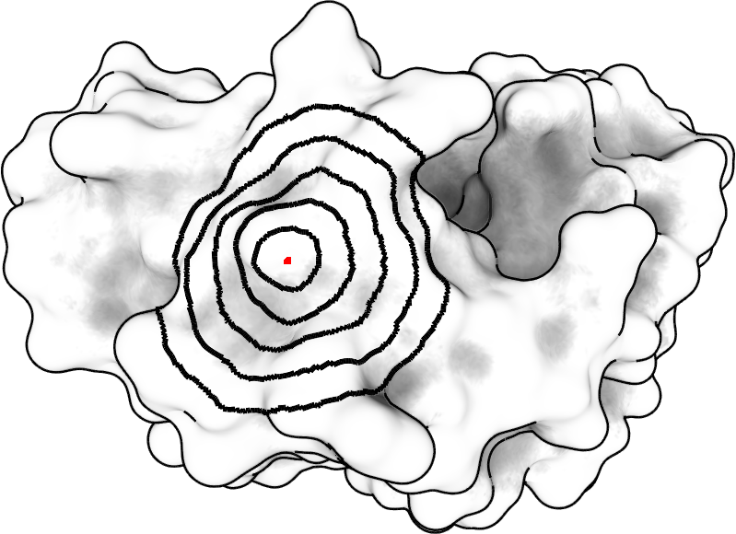
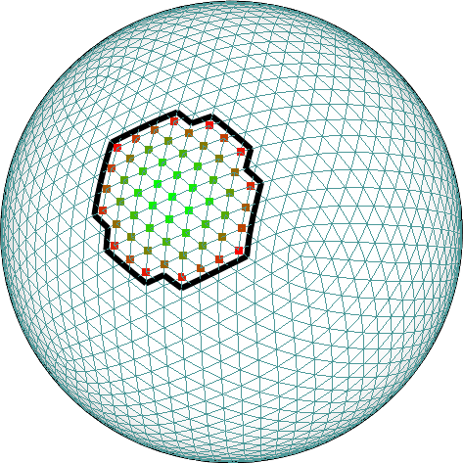
Multi-Scale Surface Descriptors
Multi-Scale
Captures phenomena of many different sizes/scales
Local Shape Descriptors
Distill shape into a vector of numbers
[1.5, 0.1, -1.5, … ]
Notes:
At it’s most abstract, the idea with multi-scale is that we capture phenomena at multiple scales.
This could be done by constructing multiple levels of detail, or as we do, by investigating the properties of regions of the surface, of varying sizes.
Independently, shape descriptors distill the properties of the shape of the surface at a point into a vector of numbers.

Slide 3
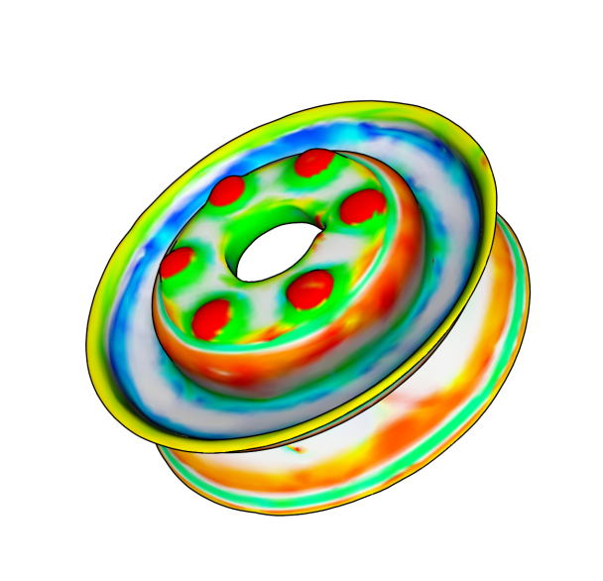
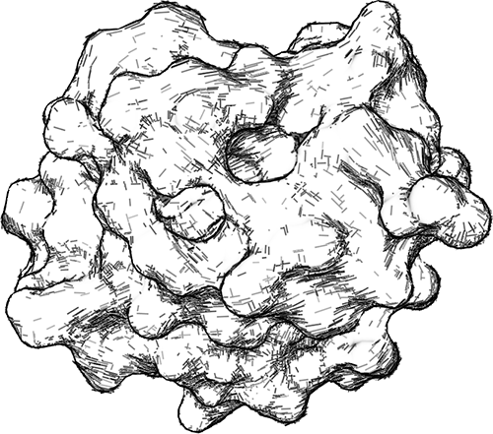
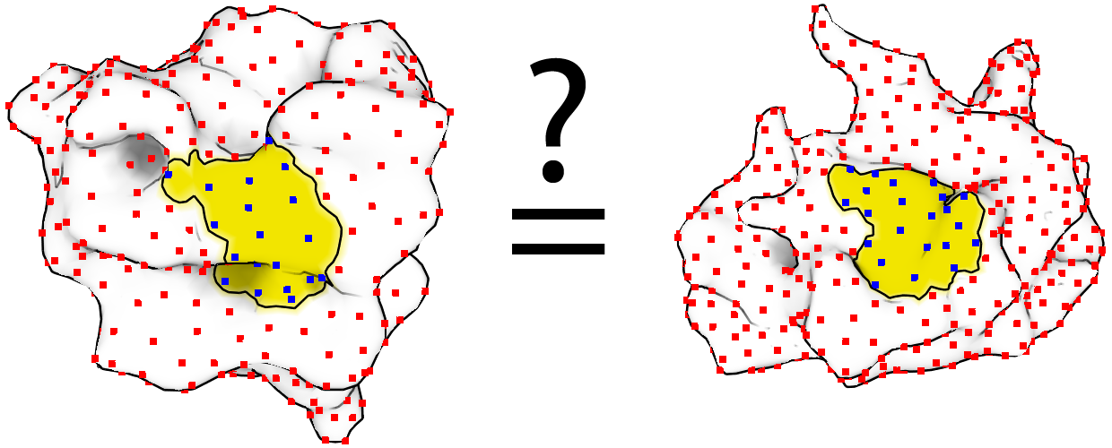
Motivation
Useful for:
Visualizing and analyzing scientific data
Stylized rendering
Shape matching
…
Notes:
Local surface descriptors have been found useful for a range of tasks, such as…

Slide 4
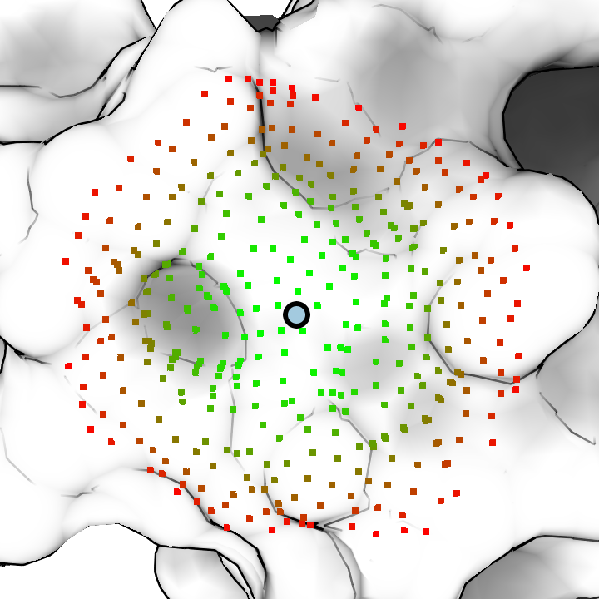
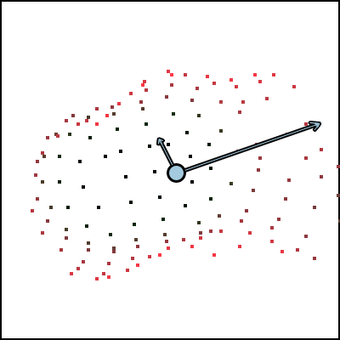
What we’re going to do
Collect regions around a point:
Statistically characterize them:
Our goal: efficient, robust, intuitive
Multi-Scale
Descriptor
Notes:
So we can break down our method along the same lines…
In the first step, we find regions of varying sizes around a given point … and as I’ll show later, this allows us to be multi-scale.
In the second, we statistically characterize them … which gives us our descriptor.

Slide 5
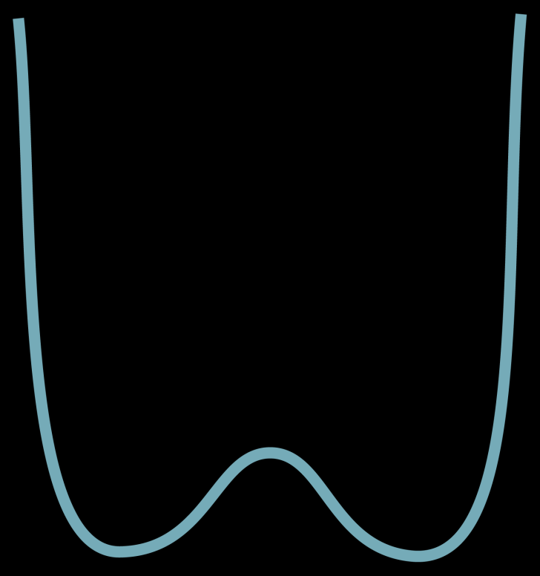
What is Multi-Scale?
Notes:
So let me go into a bit more detail about multi scale. In particular, what do we mean by capturing phenomena at multiple scales?

Slide 6
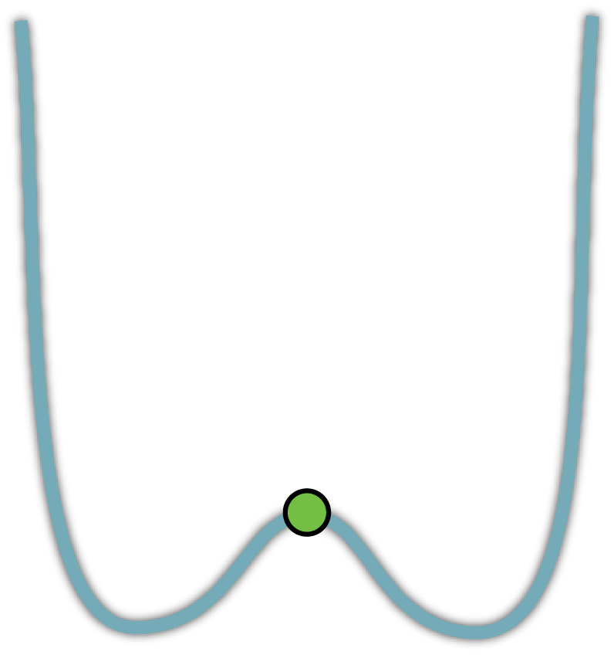
What is Multi-Scale?

Slide 7
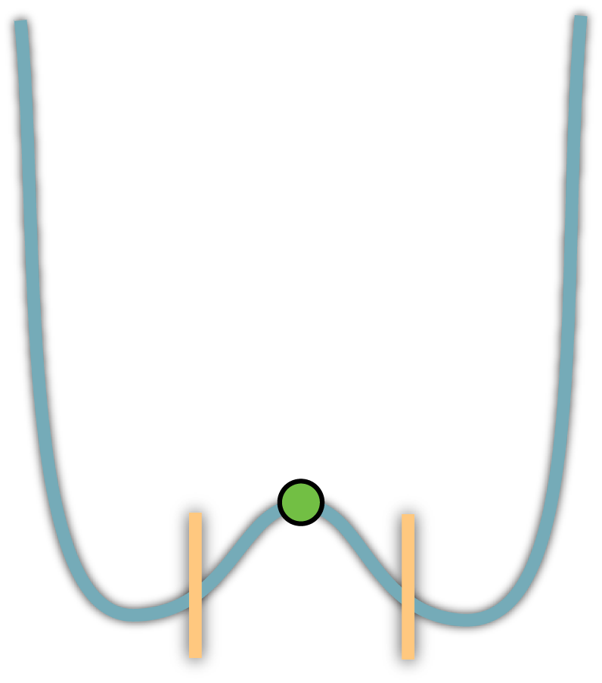
What is Multi-Scale?

Slide 8
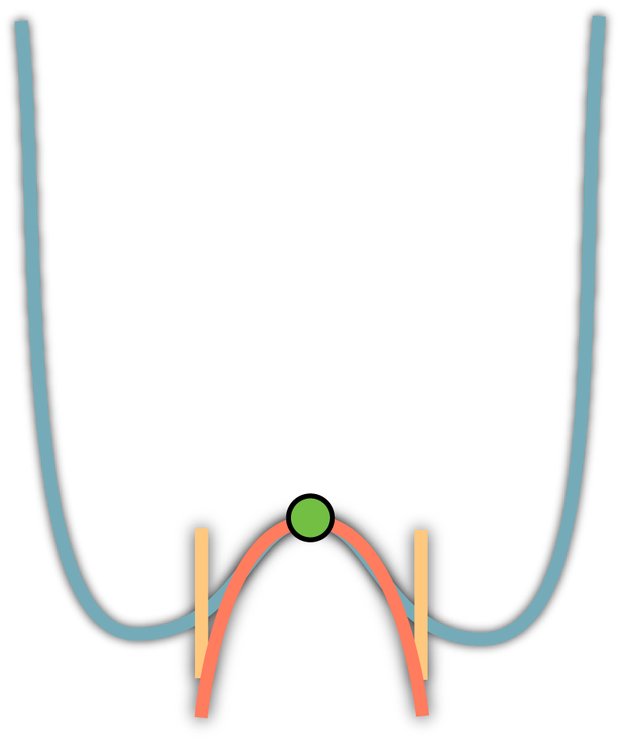
What is Multi-Scale?

Slide 9
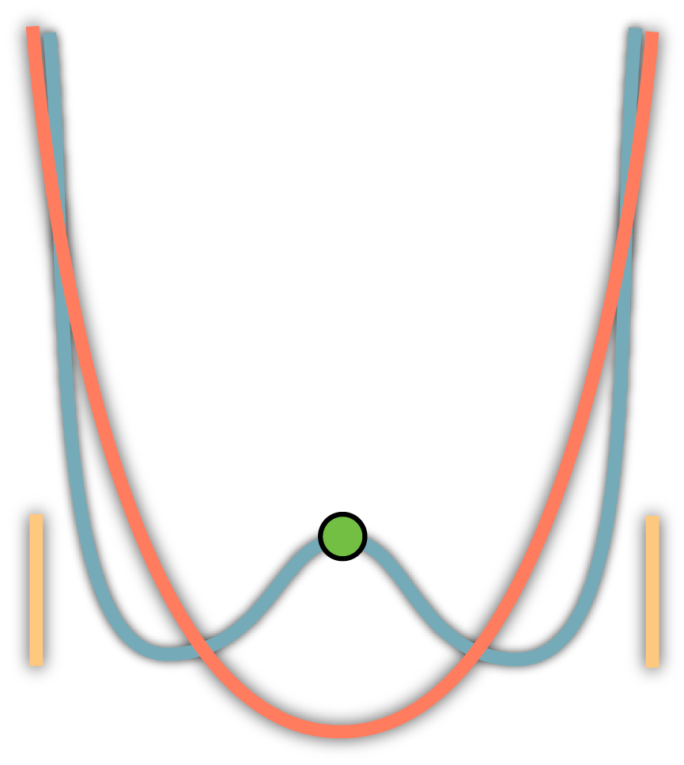
What is Multi-Scale?

Slide 10
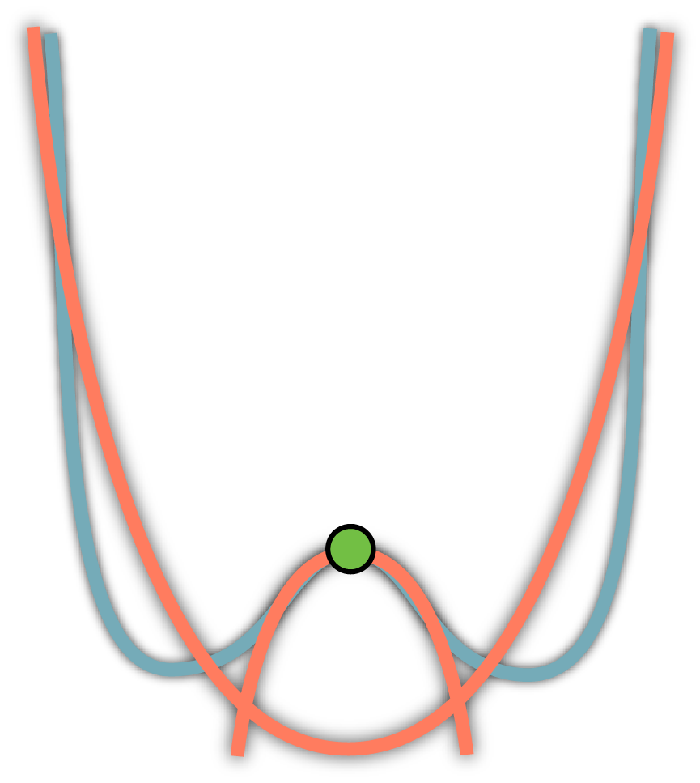
What is Multi-Scale?
Notes:
We think that to properly characterize a point on a surface, and more importantly, to get its context, you need both.

Slide 11
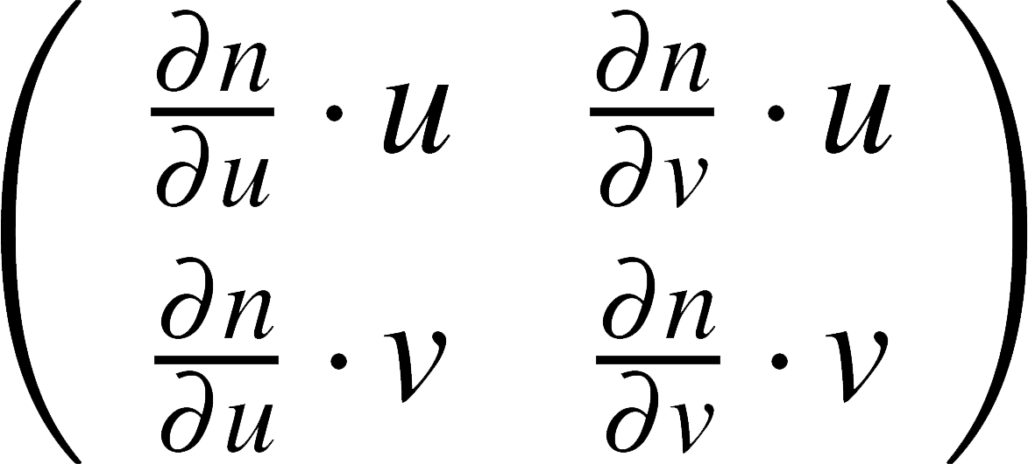
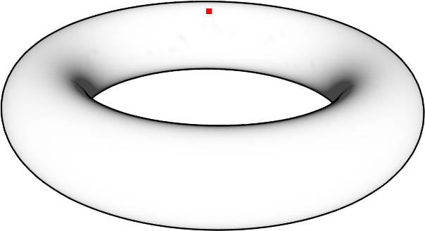
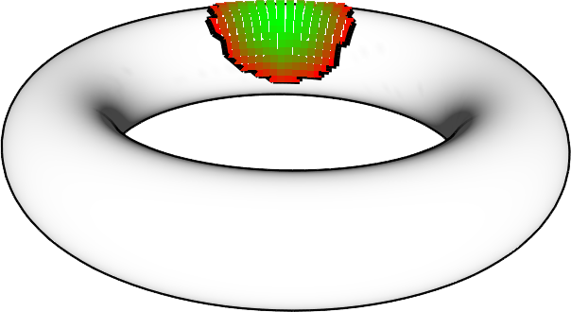
Curvature and Non-Local Curvature
?
Notes:
Curvature: intrinsic property of the surface. Perfectly characterizes an infinitesimal region. So if we have a point on this surface parameterized by u and v, we can construct a simple 2x2 tensor that describes how its very local neighborhood behaves.
Non local curvature: If we want something similar for the larger patches, we’re out of luck. The best we hope for is an approximation of that patch.

Slide 12
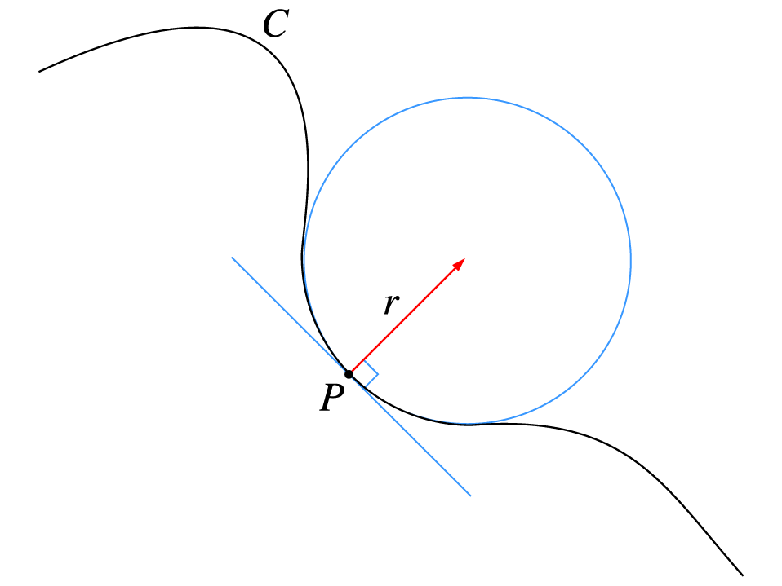
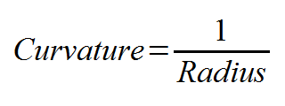
2D Curvature (a quick definition)

Slide 13
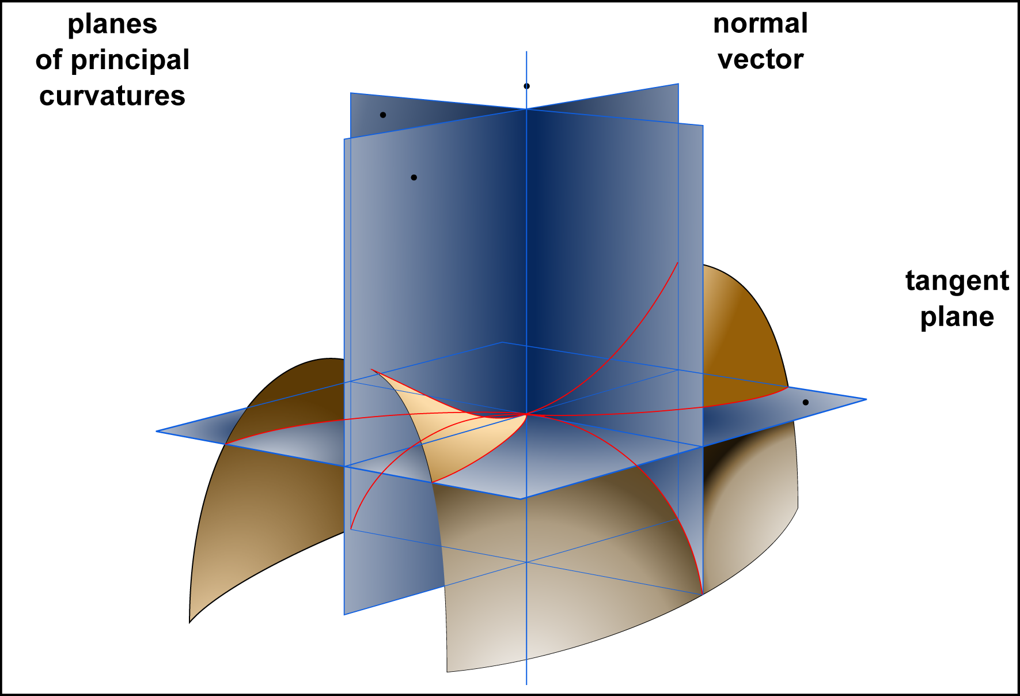
3D Curvature (a quick definition)

Slide 14
Mesh Tessellation
Curvature has a precise definition on smooth, continuous surfaces
But we work with meshes
Discrete, tessellated
Sensitive to bad mesh tessellation
Notes:
* I want to work on meshes
* Curvature is not defined… but that’s someone else’s problem
* Still, important to deal with bad tessellation

Slide 15
Local Curvature
Benefits of using local curvature:
Perfectly describes region (in the limit)
Has real geometrical meaning
Drawbacks
Cannot capture larger regions
Missing context
We want to describe the surface using something like curvature,
but at multiple scales.
Notes:
In summary…

Slide 16
Desired Features
Scales to describe larger neighborhoods
Of biologically meaningful size
Allows for simple control of scale
Compensates for issues in tessellation
Bad triangles, uneven distribution of vertices
Efficient
Intuitive
Effective (for our applications)
Matching, stylized rendering and illumination, segmentation

Slide 17
The Algorithm (at a Very High Level)
Input:
A point P, and the region around it, of a specific size D
Output:
Its characterization
4 numbers: (curvature, direction/magnitude of anisotropy)

Slide 18
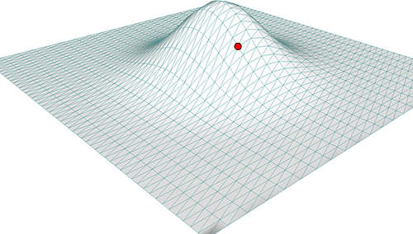
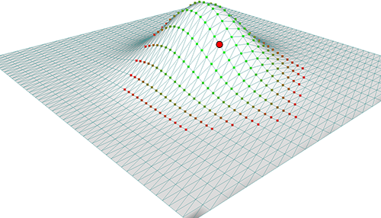
The Algorithm (at a High Level)
Neighborhood Construction
First, for P, collect points in its neighborhood, N

Slide 19
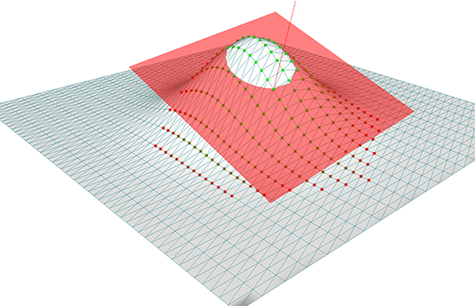
The Algorithm (at a High Level)
Neighborhood Construction
First, for P, collect points in its neighborhood, N
Project N onto a 2D height-field
Height-Field Projection

Slide 20
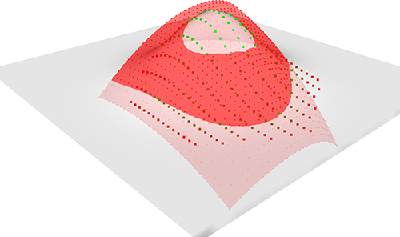
The Algorithm (at a High Level)
Neighborhood Construction
First, for P, collect points in its neighborhood, N
Project N onto a 2D height-field
Statistically characterize 2D field
Height-Field Projection
Surface Characterization

Slide 21
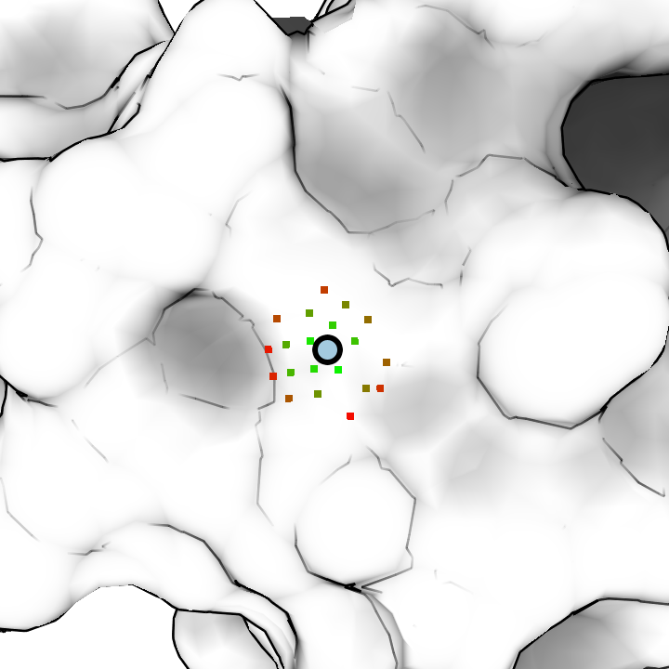
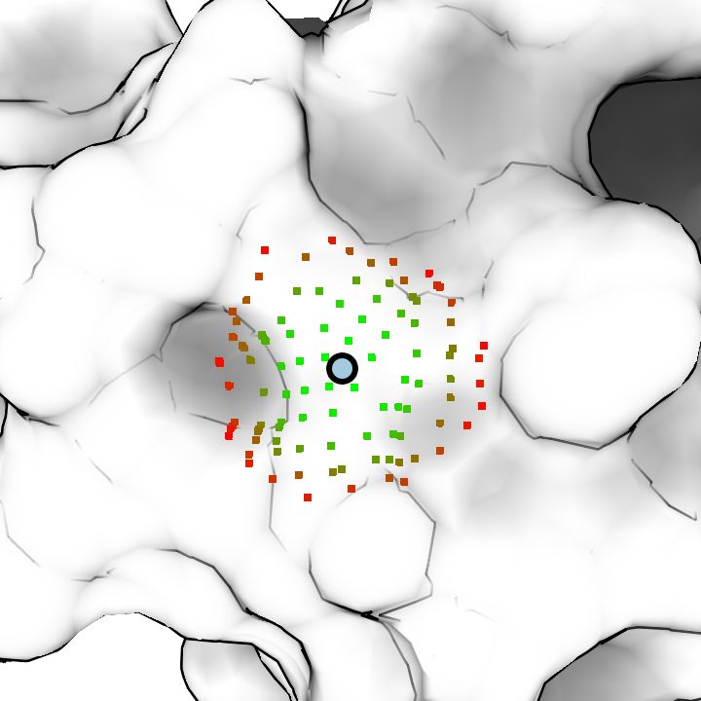
Neighborhood Construction
Neighborhood Construction
Height-Field Projection
Surface Characterization
For a given vertex, we find all points on the surface within a distance D along the surface.
Called a D-disc.
Multiple scales → varying D.
2 Å
5 Å
8 Å

Slide 22
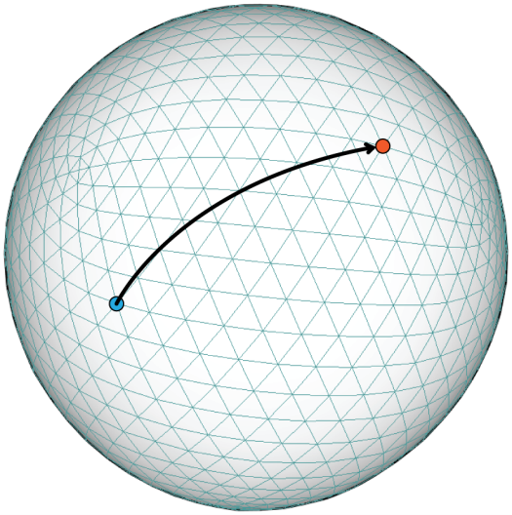
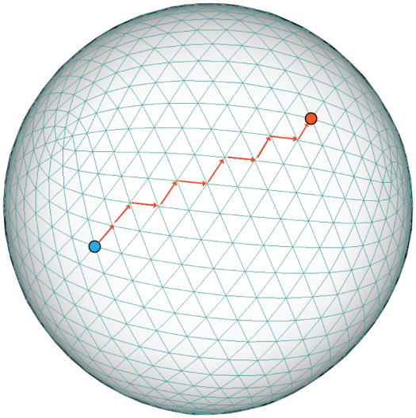
Surface Distance
Neighborhood Construction
Height-Field Projection
Surface Characterization
Geodesics
Pro: perfect distance between points
Con: slow to compute
Dijkstra (path-based)
Pro: very fast
Con: can be a poor approximation

Slide 23
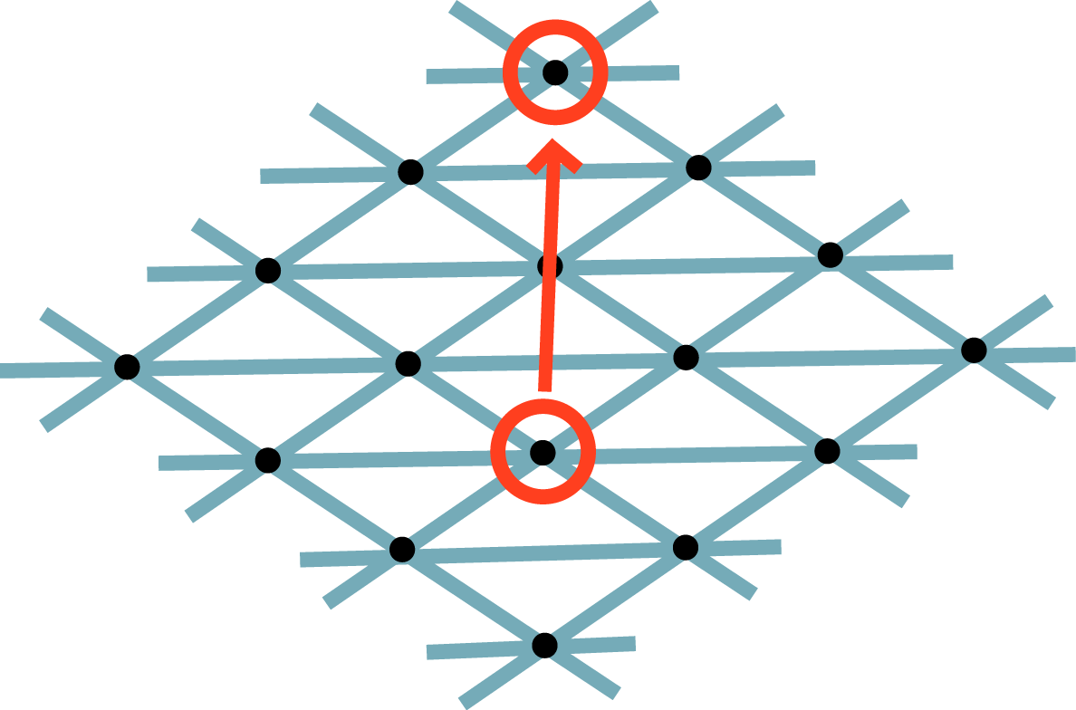
Improving Dijkstra’s Method
Neighborhood Construction
Height-Field Projection
Surface Characterization

Slide 24
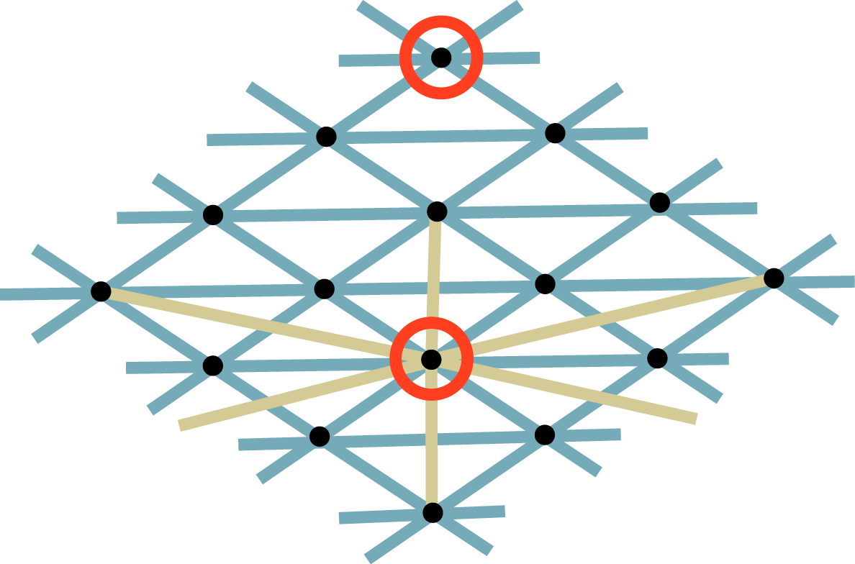
Improving Dijkstra’s Method
Neighborhood Construction
Height-Field Projection
Surface Characterization
2-Ring approximation

Slide 25
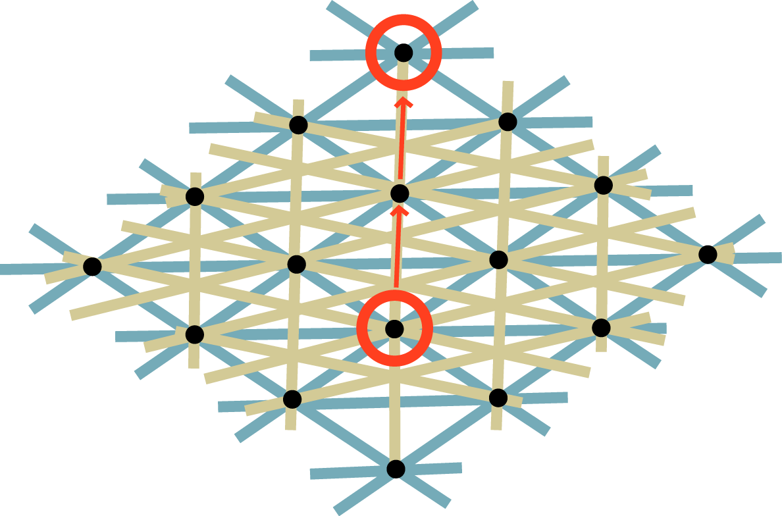
Improving Dijkstra’s Method
Neighborhood Construction
Height-Field Projection
Surface Characterization

Slide 26
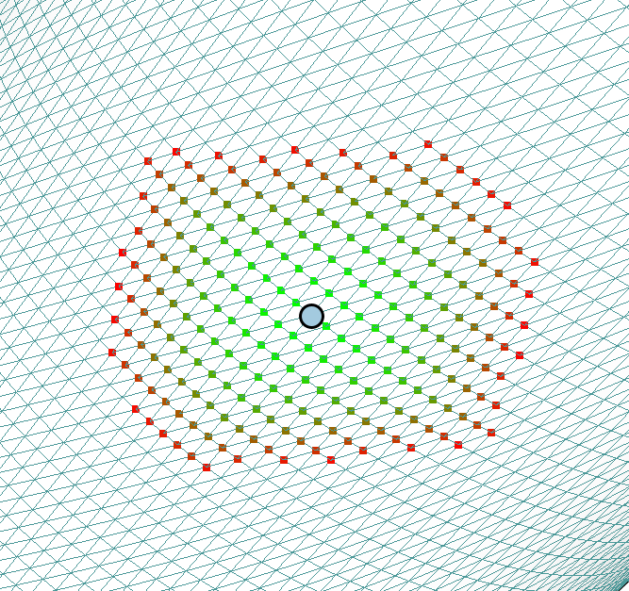
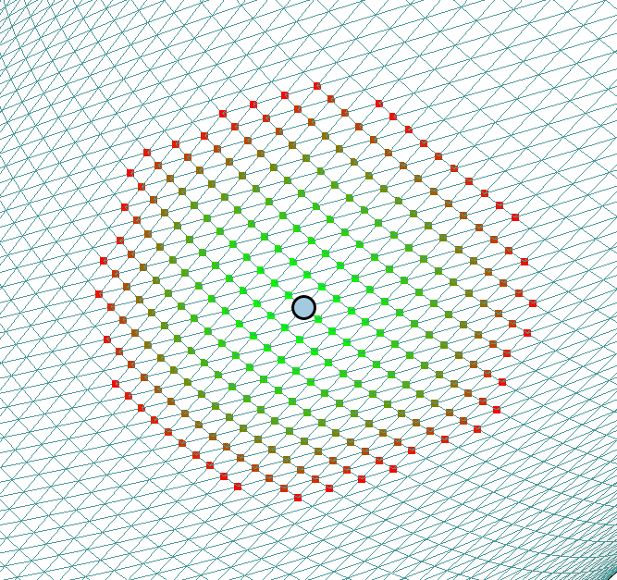
Approximating Geodesics with Dijkstra
Neighborhood Construction
Height-Field Projection
Surface Characterization
Without Correction
With 2-Ring Correction

Slide 27
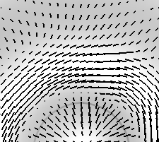
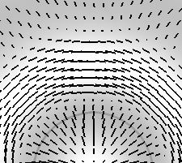
Approximating Geodesics with Dijkstra
Neighborhood Construction
Height-Field Projection
Surface Characterization
Without Correction
With 2-Ring Correction

Slide 28
Geodesics vs. 2-Ring Approximation: How bad are we?
Neighborhood Construction
Height-Field Projection
Surface Characterization
On average:
Dijkstra patch shares 76% - 90% vertices in common with geodesic
Our modification brings this up to 92% - 100%
Missed vertices on outer ring

Slide 29
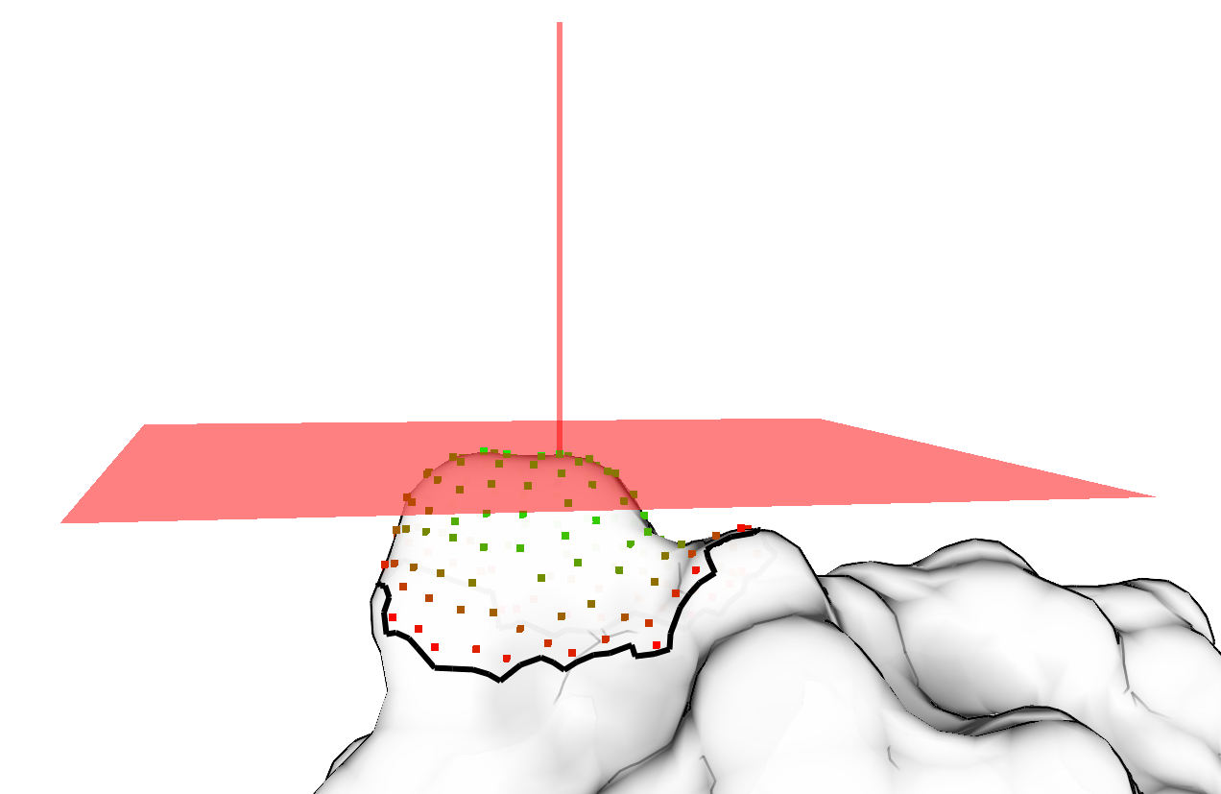
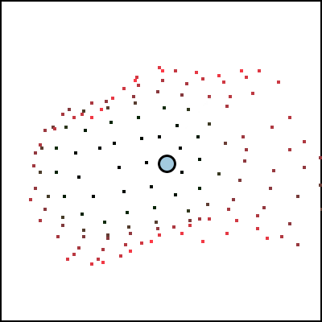
Height Field Projection
Neighborhood Construction
Height-Field Projection
Surface Characterization
A height field is a 2D function of u, v:
Why map the data to a height field?
Projection reduces the problem of fitting a 3D quadric to a simpler 2D problem

Slide 30
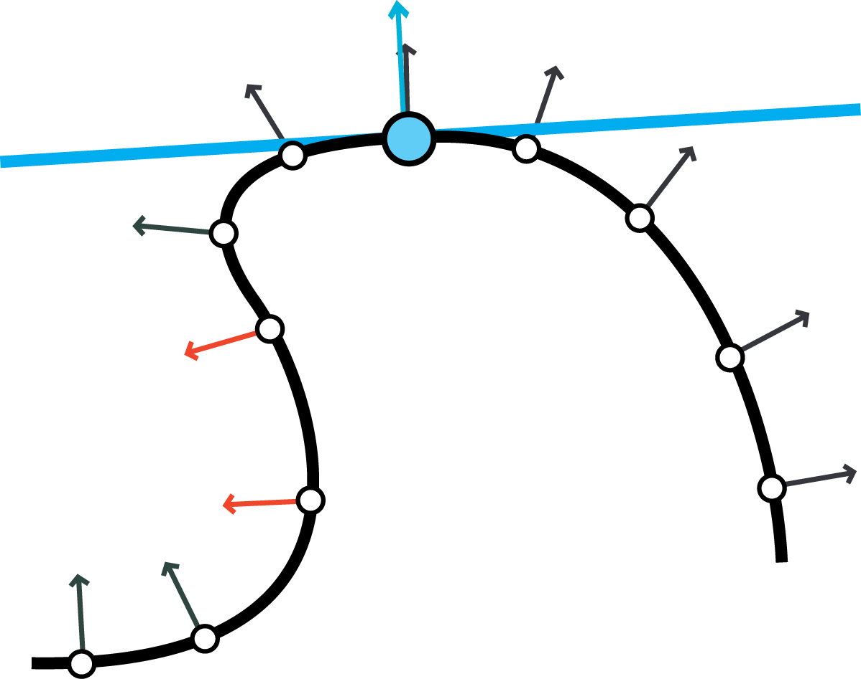
Height Field Robustness
Neighborhood Construction
Height-Field Projection
Surface Characterization
Height Field function should not fold over itself
Or it’s not a function!
Simple solution
Throw away vertices that point away from the height field normal
Works well in practice
On average these vertices account for 23 ± 12% of all vertices in the largest patches (d = 8 Ångströms)
Much less in smaller patches
Still plenty of data to work with

Slide 31
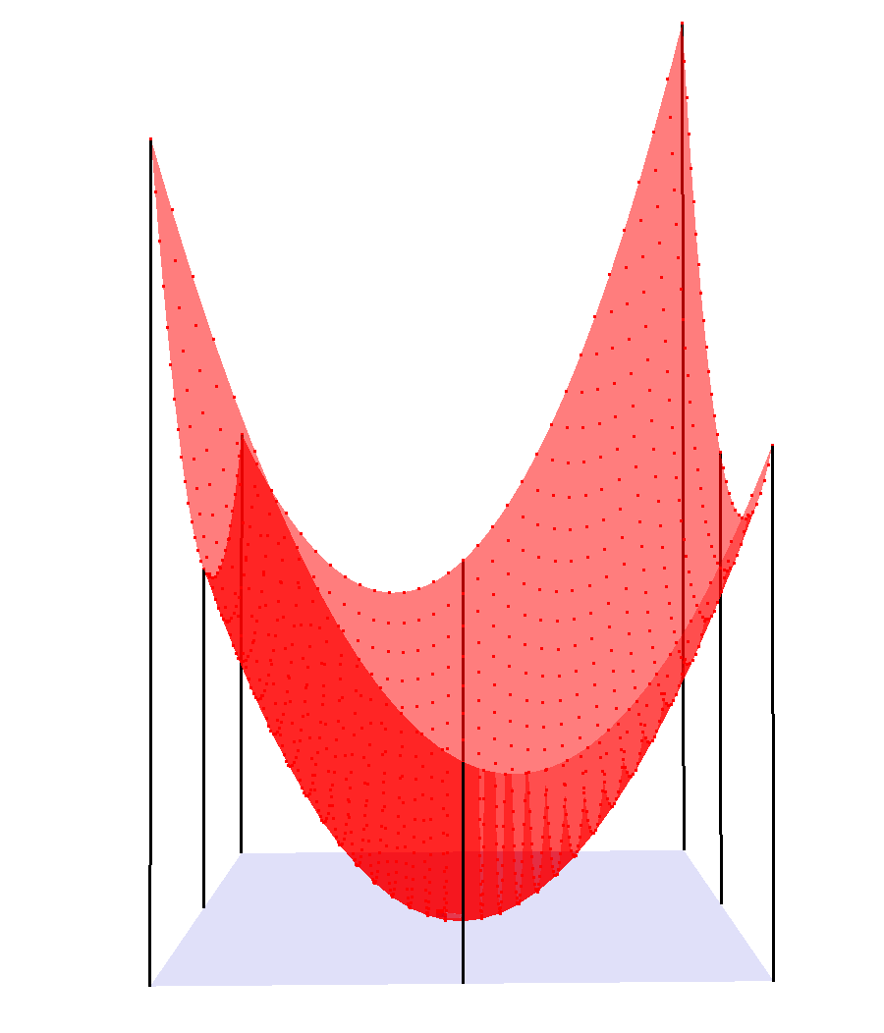
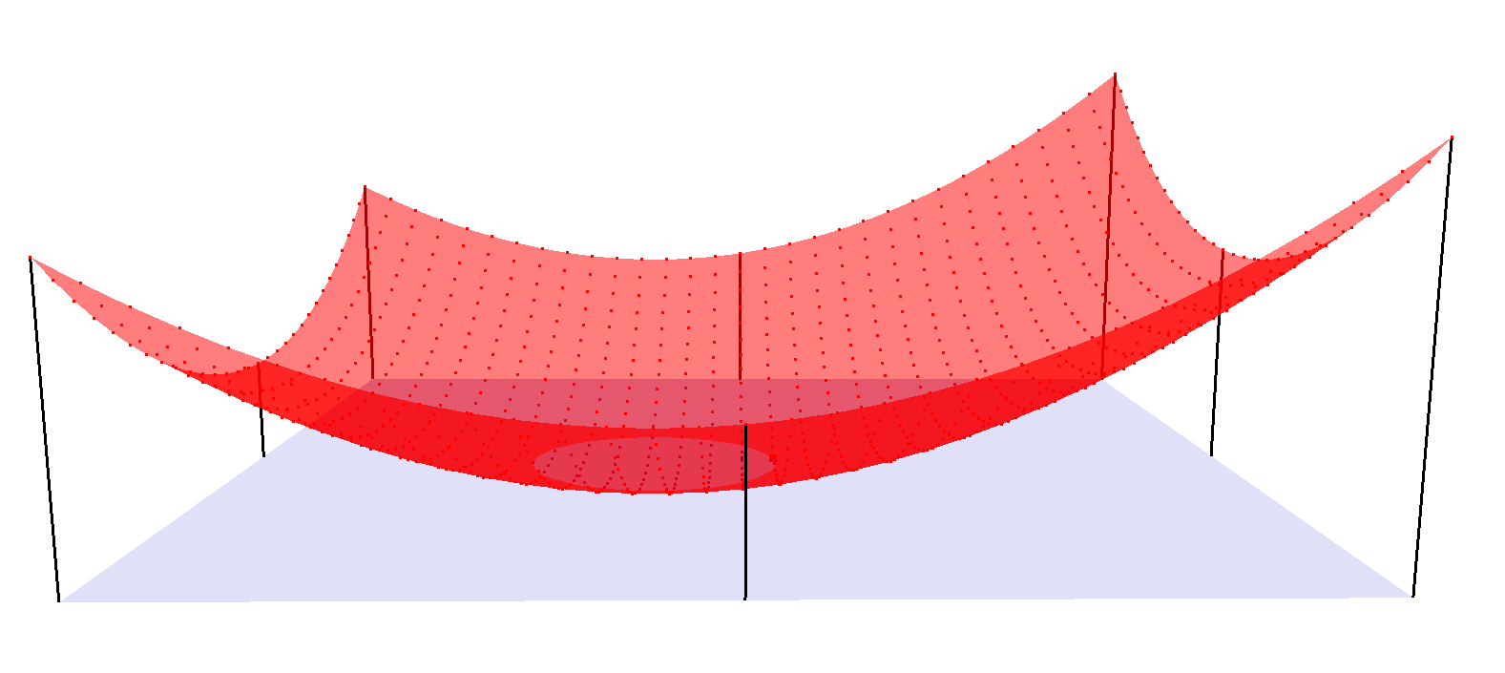
Surface Characterization
Neighborhood Construction
Height-Field Projection
Surface Characterization
Shallow Bowl vs. Deep Bowl

Slide 32
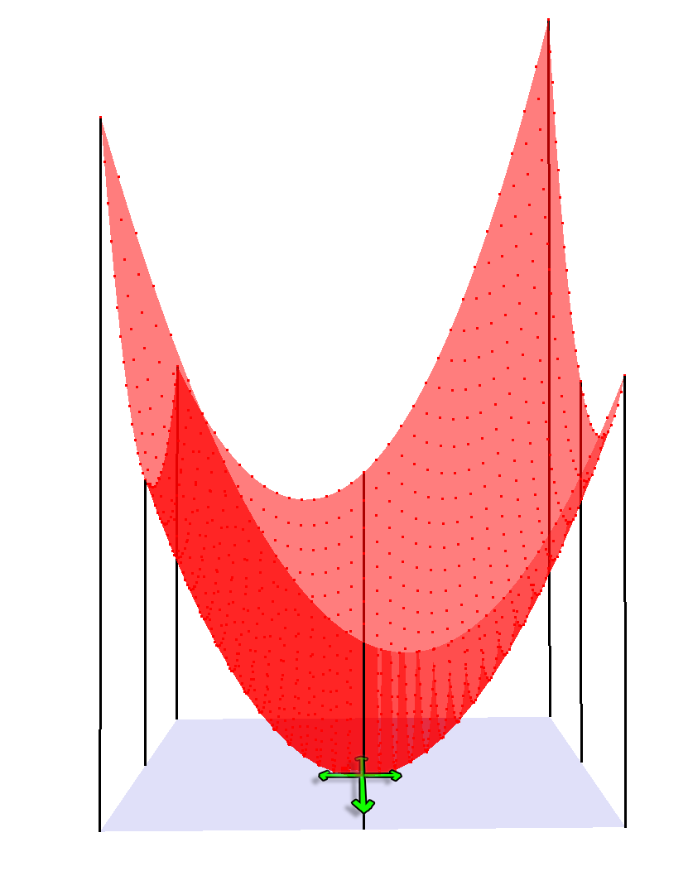
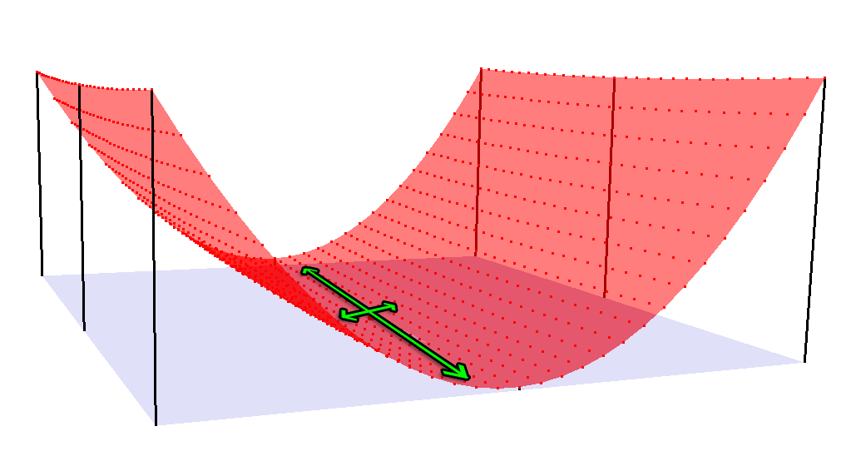
Surface Characterization
Neighborhood Construction
Height-Field Projection
Surface Characterization
Degree and Direction of Anisotropy
Anisotropic
Isotropic
Notes:
Anisotropic: More like a cylinder
Isotropic: More like a symmetric paraboloid

Slide 33
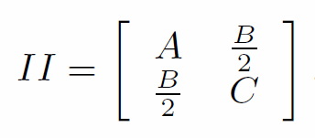
Characterization Method ‘A’: Fitting a Quadratic Surface
Neighborhood Construction
Height-Field Projection
Surface Characterization
With a set of u, v and z known, we solve for A, B, C, D and E:
It’s easy to get them out using the second fundamental form:
Values contained in descriptor:
Mean curvature (average of its eigenvalues)
Anisotropy magnitude (ratio of largest to smallest eigenvalue)
Anisotropy direction
Notes:
Now we have patch of surface, and a height field describing that patch. So how do we relate that to curvature?
Like I said: curvature is only valid on smooth surfaces
So we need a smooth approximation of the points
Large Linear System!

Slide 34
Characterization Method ‘B’: Moment-Based Surface Description
Neighborhood Construction
Height-Field Projection
Surface Characterization
An example neighborhood:
Insights:
The major axis of image intensity → principle axis of minimum curvature
Ratio of axis lengths → image anisotropy → surface anisotropy
Notes:
We can get at the same thing by looking at the statistics of the heightfield, and using them directly as a descriptor.

Slide 35
Evaluation: Performance
30 mesh corpus
Intel Core2 Duo E8500, 3GB RAM
Speed ~O(VN), where V = # verts and N = largest patch size
 | # Verts | Neighborhood Construction | Fitting Quadratic | Moment Calculation
Smallest Mesh | 2,600 | 1.5s | 1.5s | .5s
Largest Mesh | 170,000 | 2 min | <2 min | <1 min

Slide 36
Evaluation: Quadratic vs. Moments
Test:
Compare anisotropy direction, curvature
Quadratics are “ground truth”
Results:
Curvature Agreement: .81 < R² < .95
Avg. Angular Difference: 16◦ ± 12◦

Slide 37
Evaluation: Quadratics vs. Local Curvature
Test:
Again, compare anisotropy direction, curvature
Local curvature = “ground truth”
Held neighborhood to 2 rings
Results:
Avg. Curvature Agreement: R² ~= .83
Avg. Angular Difference: 14◦ ± 11◦

Slide 38
Evaluation: Noise Sensitivity
Test:
Randomly perturb each vertex along its normal (by 5 Å)
Compare curvature before and after
Results:
Local Curvature → 25% ± 36%
2 Å neighborhood → 19% ± 26%
8 Å neighborhood → 2% ± 6%

Slide 39
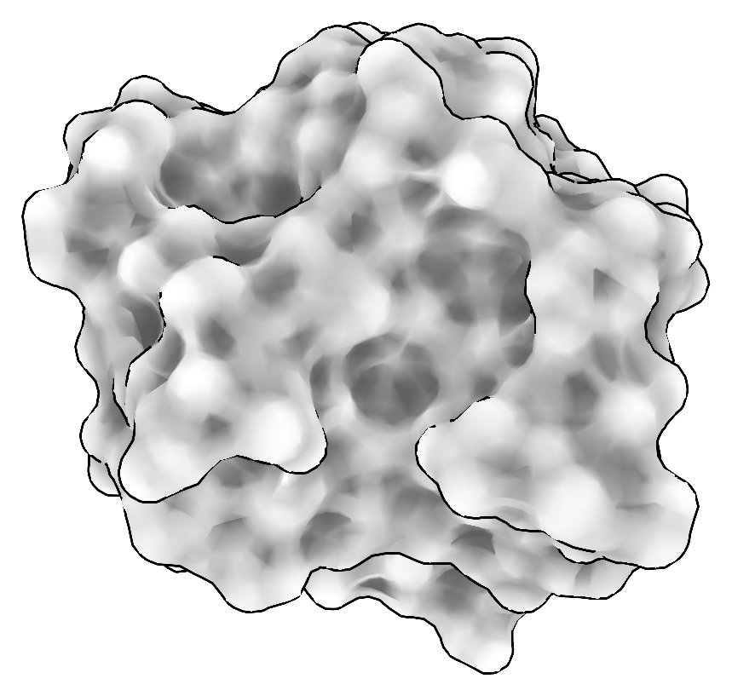
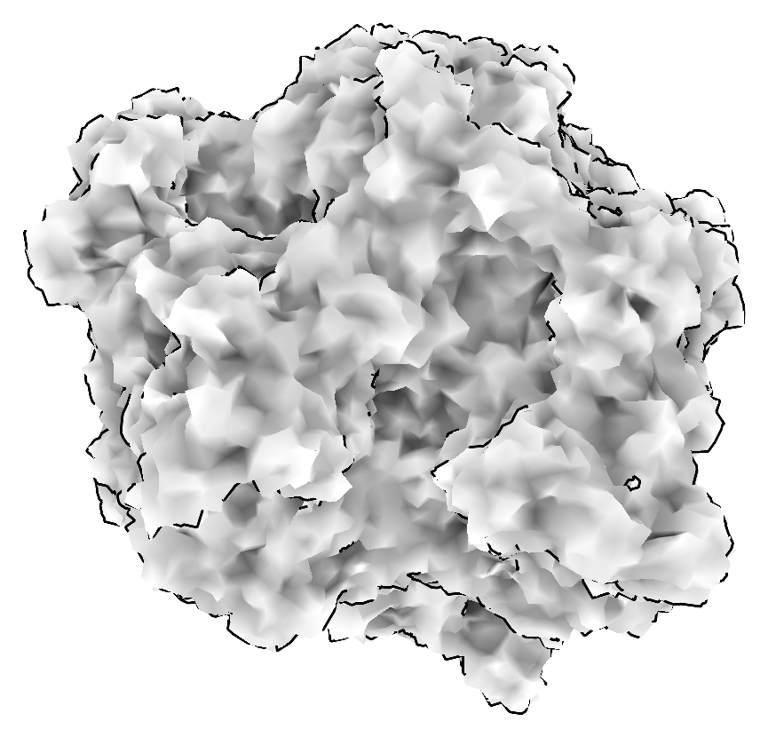
Evaluation: Noise Sensitivity
Test:
Randomly perturb each vertex along its normal (by 5 Å)
Using local (1 ring) neighborhood

Slide 40
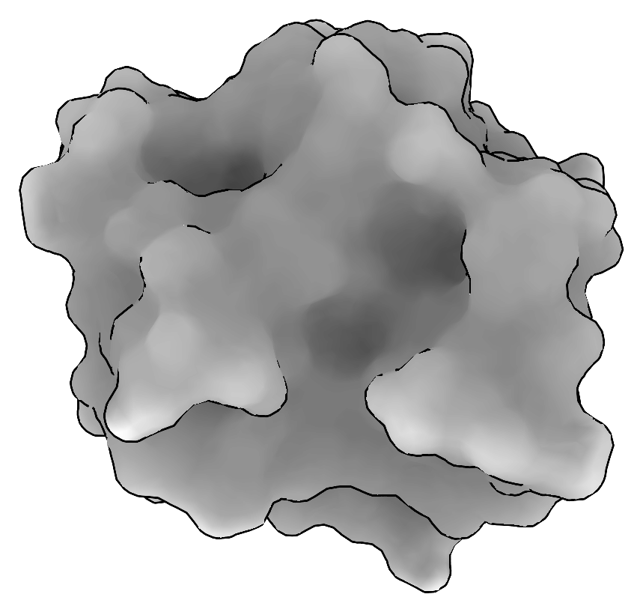
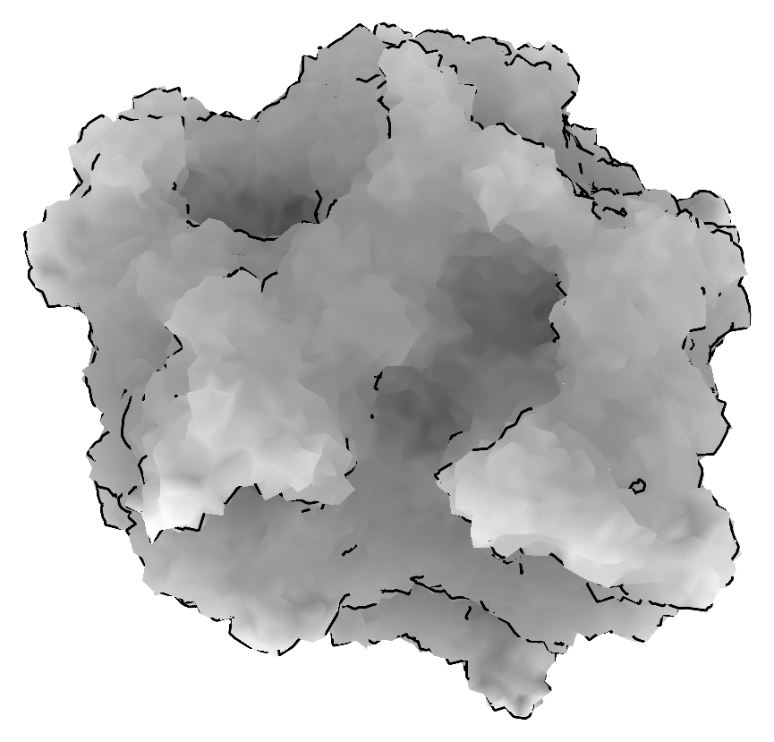
Evaluation: Noise Sensitivity
Test:
Randomly perturb each vertex along its normal (by 5 Å)
Using large (8 Å) neighborhood

Slide 41
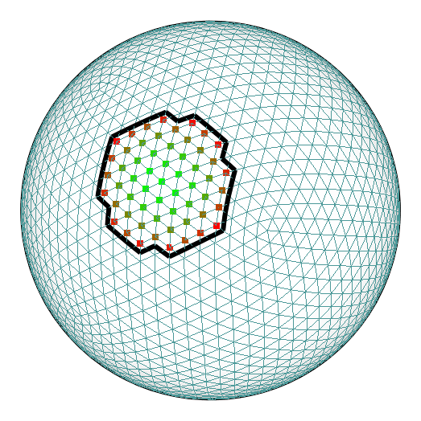
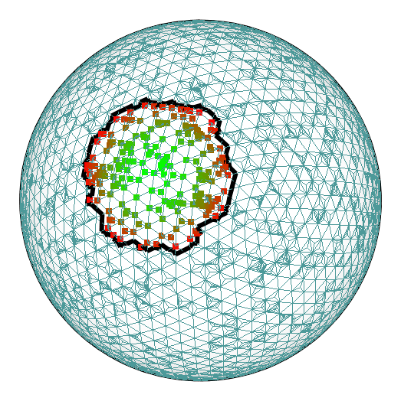
Evaluation: Tessellation Sensitivity
Test:
Insert points by randomly tessellating object

Slide 42
Evaluation: Tessellation Sensitivity
Test:
Insert points by randomly tessellating object
Tested only analytical models (sphere, torus)
Otherwise, not obvious where to place new points
Results:
 | # Verts Before | # Verts After | Error (2 Å) | Error (8 Å)
Sphere | 2,562 | 7,562 | .02% ± .01% | .2% ± .1%
Torus | 4,800 | 9,800 | .07% ± .1% | 1% ± .3%

Slide 43
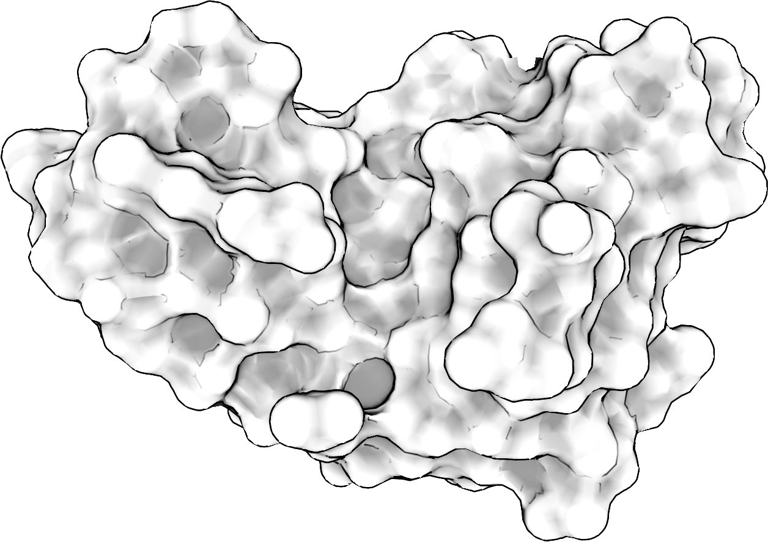
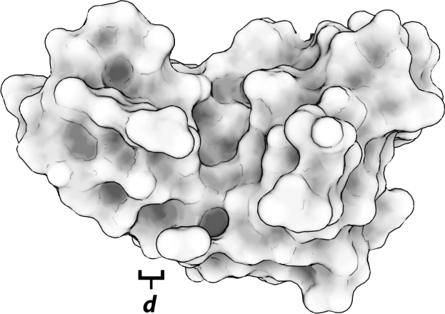
Application: Multi-Scale Lighting
Local
Curvature
Small
Descriptor
Large
Descriptor

Slide 44
Application: Watershed Segmentation
Local Curvature
Large
Descriptor

Slide 45
Application: Stylized Hatching
Local Curvature
Large
Descriptor

Slide 46
Application: Matching (curvature only)
1M07
2I5S

Slide 47
Application: Matching (full descriptor)
1M07
2I5S

Slide 48
Conclusion
Multi-Scale Surface Descriptors:
Characterize a surface at multiple-scales
Built to meet robustness, speed goals
Fit intuitions about curvature
Useful in a broad range of applications
Notes:
Add key ideas

Slide 49
Thanks!
Questions?
Thanks also to CIBM grant NLM-5T15LM007359

Slide 50
Characterization Method ‘B’: Moment-Based Surface Description
These axes can be found by constructing the second-order central moments:
Then the eigenvectors of: correspond to the major and minor axes of image intensity.

